Slide 1

COVID-19 Comprehensive Study CSPB-4502 Data Mining Project
Mohammed Alsailani
Andrew Byrnes
Collin Coakley
Gilberto Zamarron
5/1/2024

Slide 2

Introduction
Our project focuses on analyzing data surrounding COVID-19, including deaths, vaccination rates, and cases viewed on a per-county basis, covering dates from 1/1/2020 to 9/17/2022. Our group decided to use the COVID-19 Open Data by Google¹. The intriguing questions we aim to answer are:
How do local variables, such as temperature and mobility rates, affect COVID rates?
Did high vaccination rates help mitigate the deaths and spread of the virus?
Understand the impact of detailed weather variables on COVID-19 rates
How do regional outbreaks occur and do them spread between states/counties?
¹https://health.google.com/covid-19/open-data

Slide 3
Tools and Methodology
Overleaf
Git/GitHub
Python:
Pandas
NumPy
Geopandas
Sklearn
Matplotlib
Agile Method:
Weekly check ins
Dedicated time to work individually and as a group
Shared goals for the week
Helped others troubleshoot obstacles

Slide 4
Data Preprocessing
Data Transformation:
Standardized incidence rate per 100,000
Min-Max Scaling implemented
Data Repositories:
Primary GitHub repository
Storage of all county CSVs for analysis and a subset for testing data mining strategies.
Data Reduction:
Focus on the U.S.
Dimension reduction
Data Cleaning
Made data consistent amongst all files
Excluded attributes lacking too much data
Notes:
Since data was entered from different counties had to do some data preprocessing Data Transformation: Standardized incidence rate per 100,000 people to ensure fair comparison across regions. Min-Max Scaling implemented for values between 0 and 1, facilitating visualization with color schemes. Data Repositories: Primary GitHub repository: DataMiningProjectSpring2024 Storage of all county CSVs for analysis and a subset for testing data mining strategies. Data Reduction: Focus on the U.S. due to available data richness. Dimension reduction employed to handle high dimensionality and improve data relevance by removing redundant data.

Slide 5
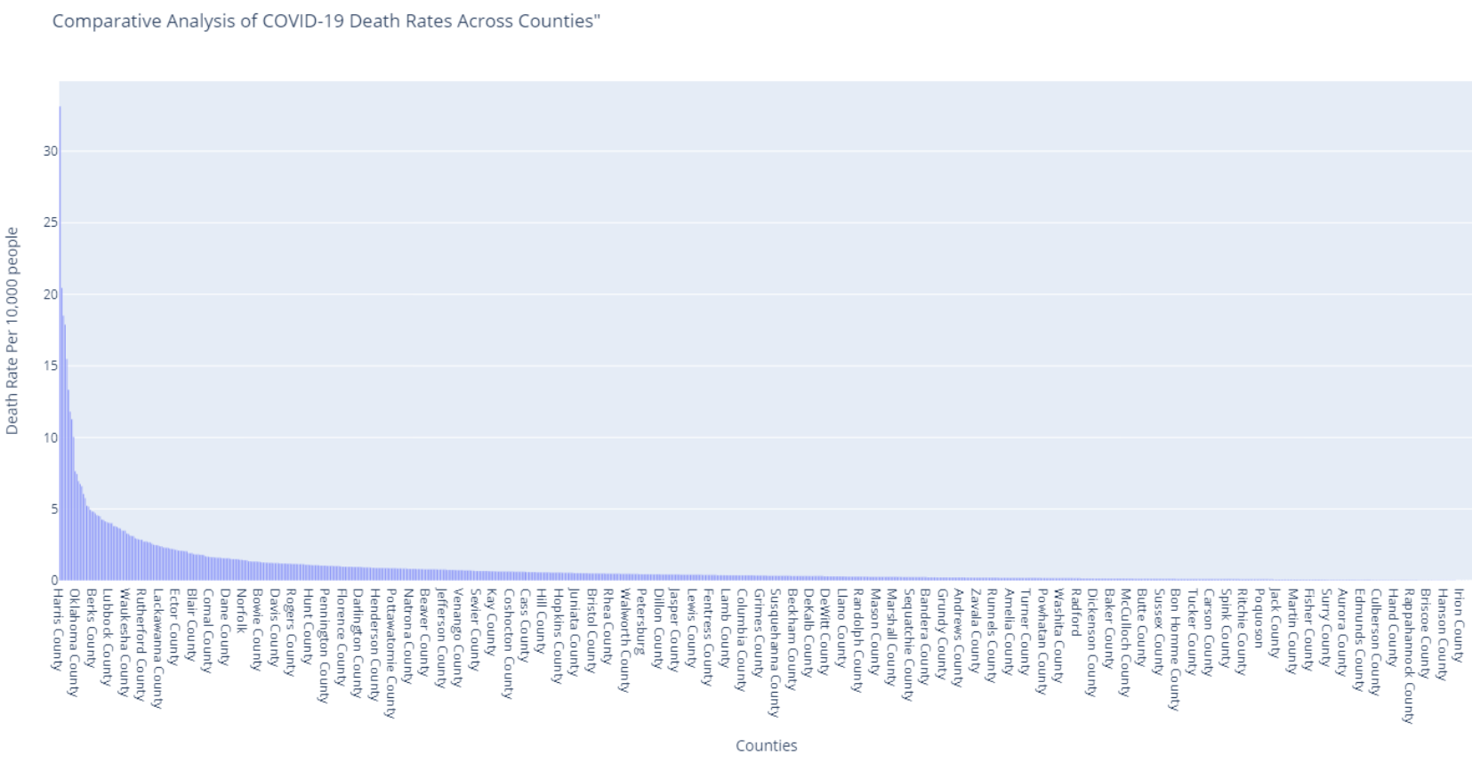
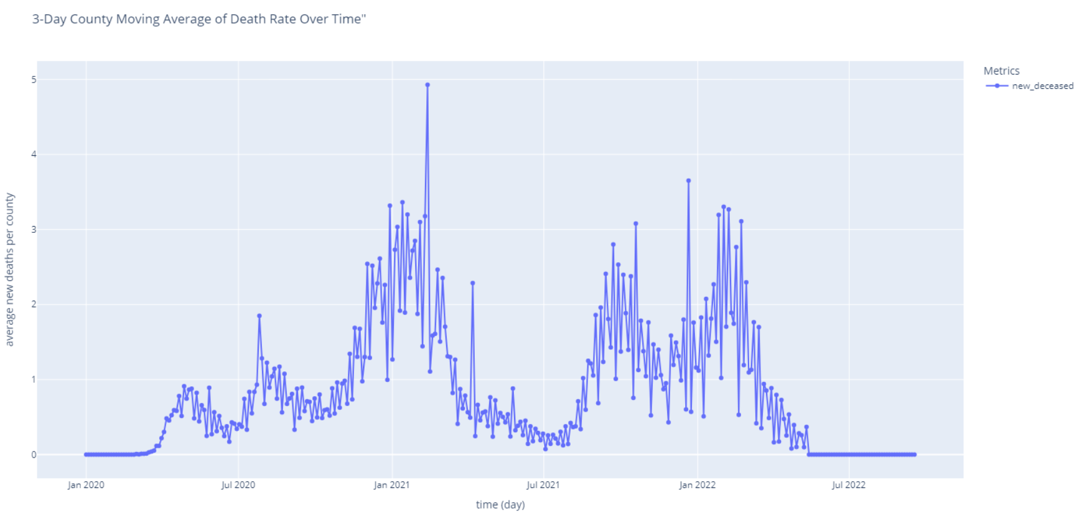
Preliminary plots (data familiarization)
Temporal graphs
Bar charts
Notes:
To gain a better understanding of our data, we analyzed temporal charts to identify interesting patterns and potential trends. We used bar charts specifically to identify outliers within the data. As shown, Harris County was a significant outlier. It's also important to note that the chart accounts for population size by standardizing the data per 100,000 people

Slide 6
Geospatial Analysis
Used TIGER/Line Shapefiles to color each county to get more accurate representation of severity at a particular time interval
Aggregated different timeframes ranging from 3-day intervals to 1-year intervals
Binned to examine different scopes.
We used the Python module Geopandas to facilitate plotting.

Slide 7
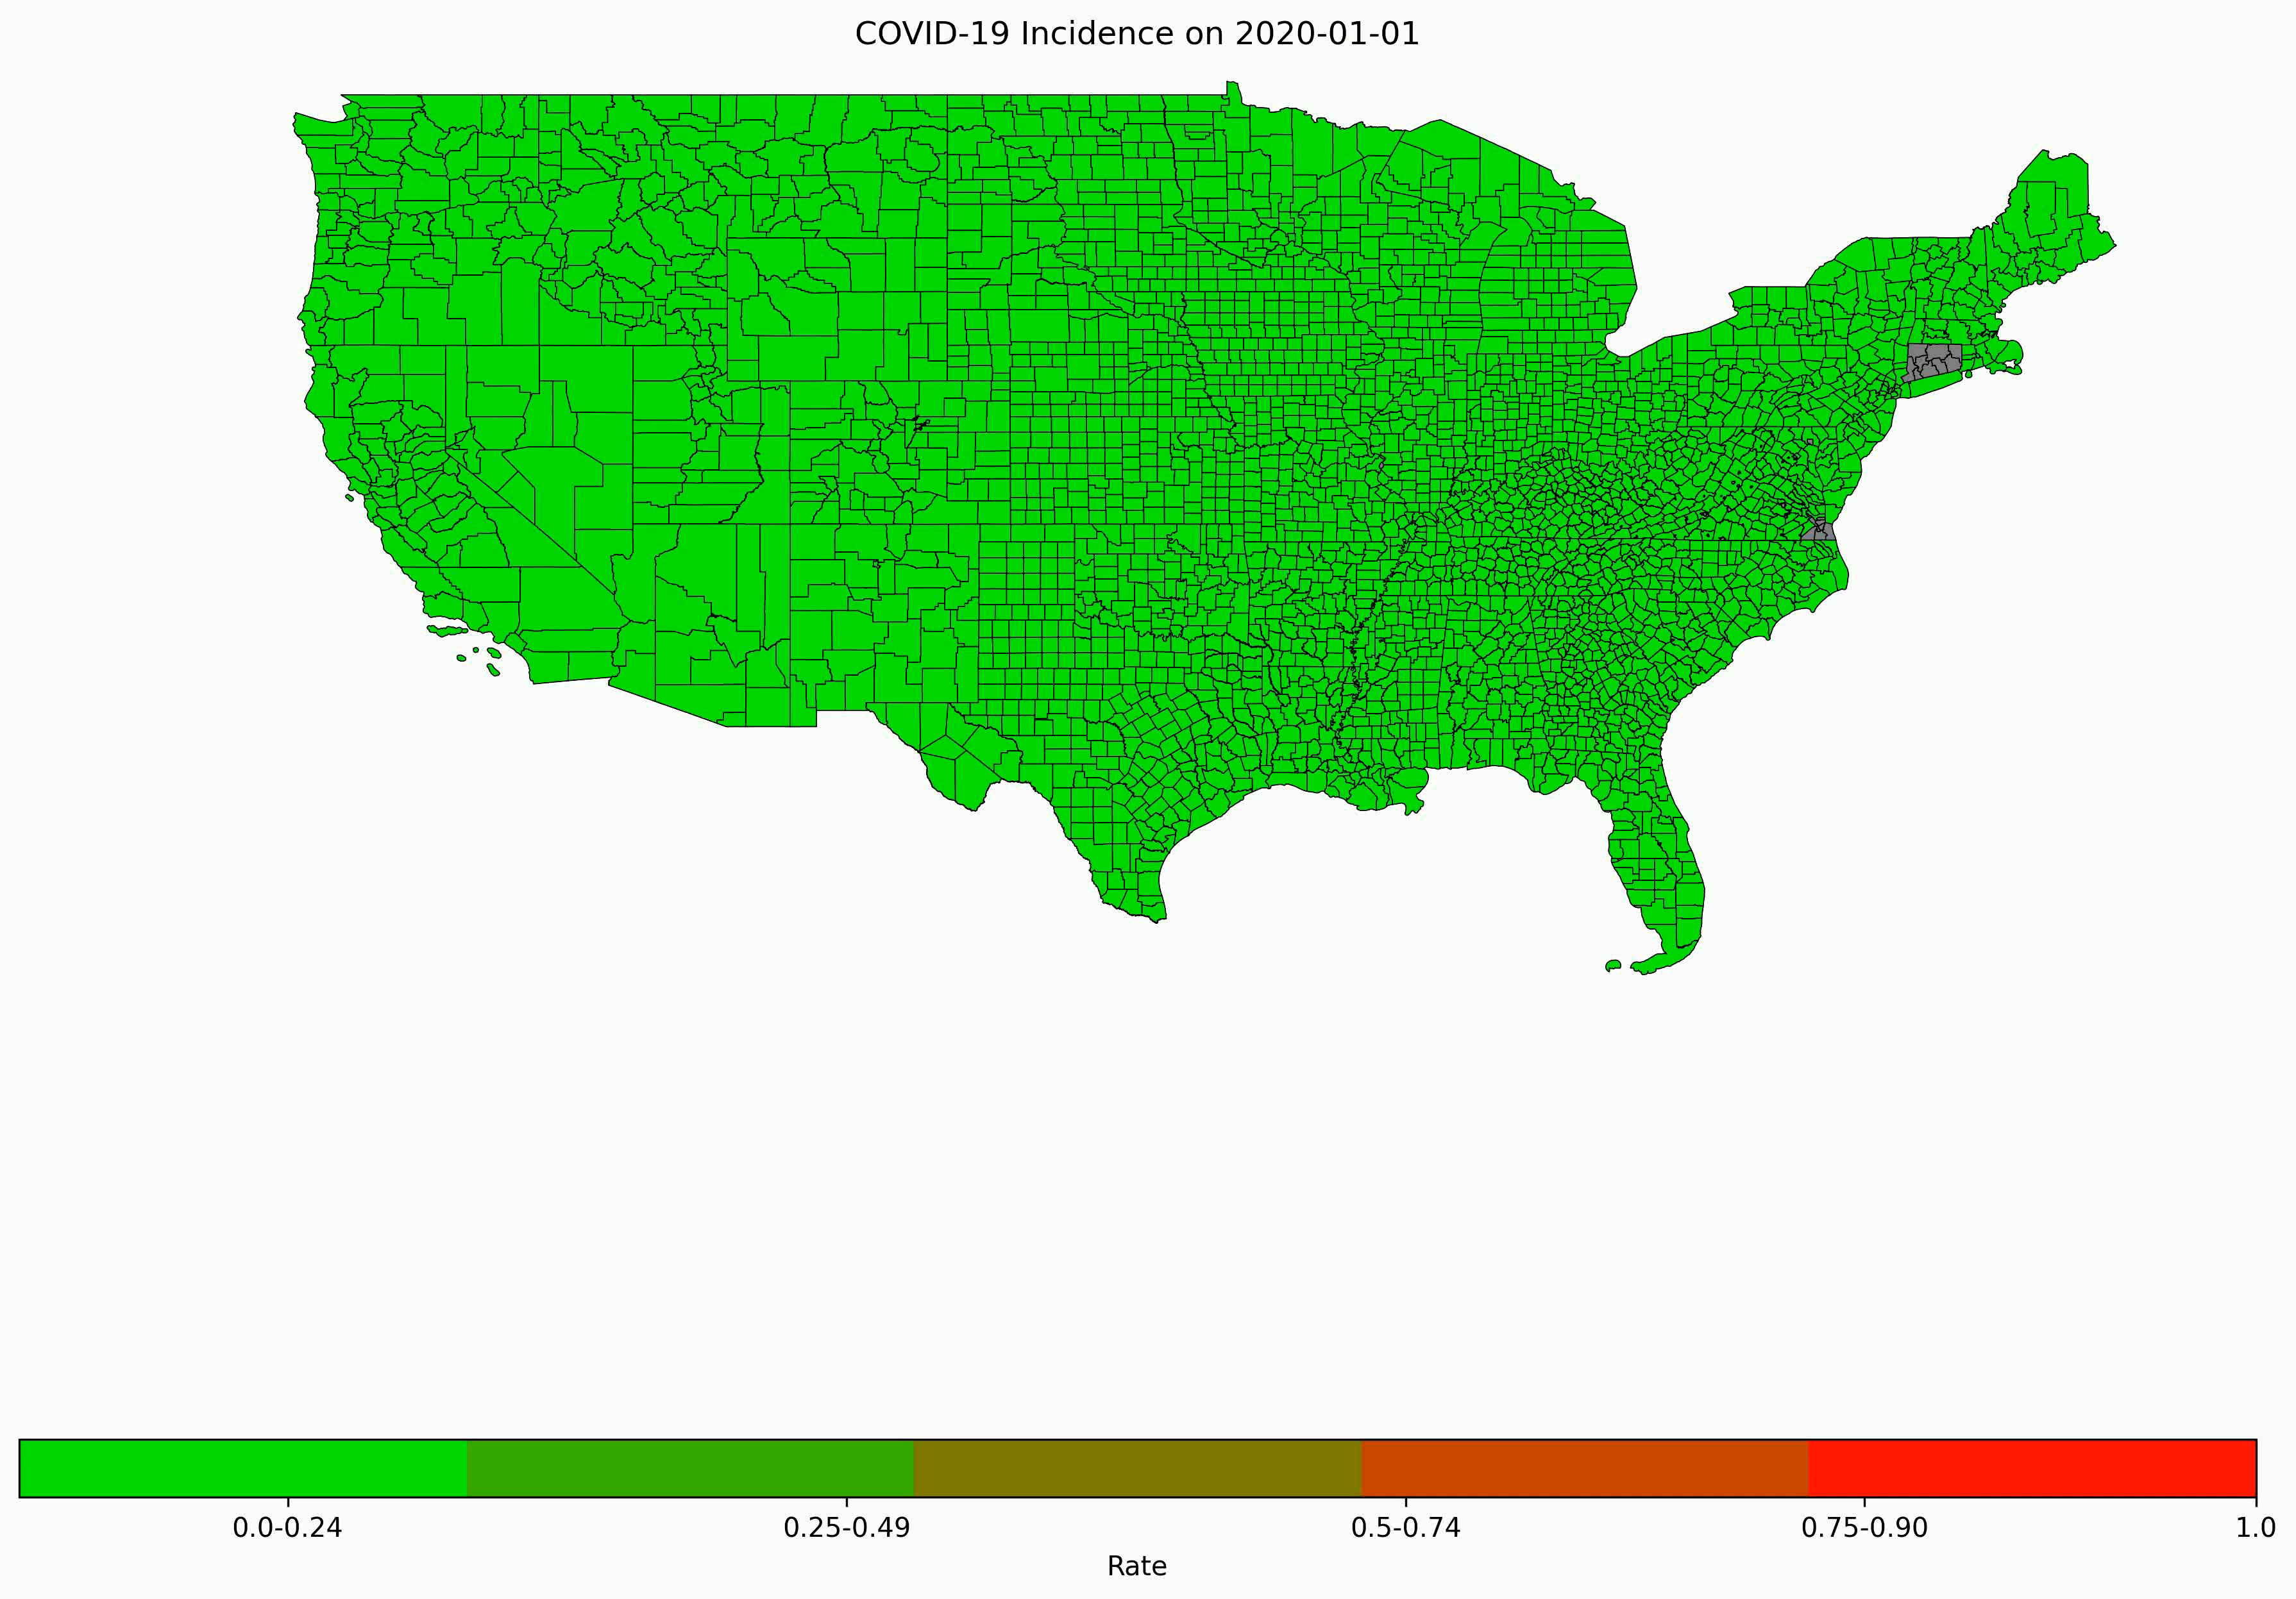
Geospatial Progressive Timelapse
Seem to have two waves of covid.
Regions with outbreak seem to expand to others.
Aggregation based on 17 days, per normalized per 100,000
Notes:
This video illustrates the progression of COVID-19, highlighting two significant waves of infection. It demonstrates how initial outbreaks in specific regions likely led to subsequent outbreaks in neighboring areas, showcasing the dynamic spread of the virus over time."
This phrasing better captures the dynamic and visual aspects of the video presentation.

Slide 8
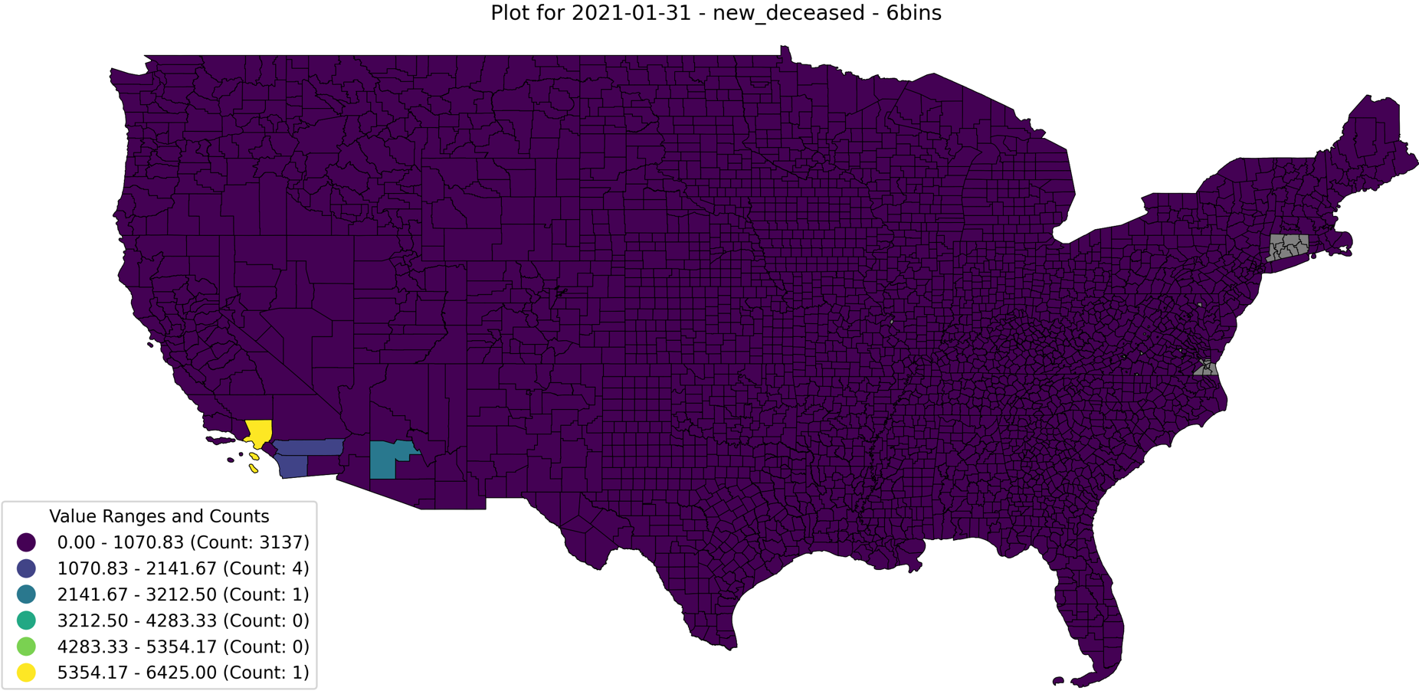
Geospatial on Worst County Outbreaks
During December 2020 through February 2021, the West Coast had a significant breakout.
Used binning to emphasize contrast for worst counties

Slide 9
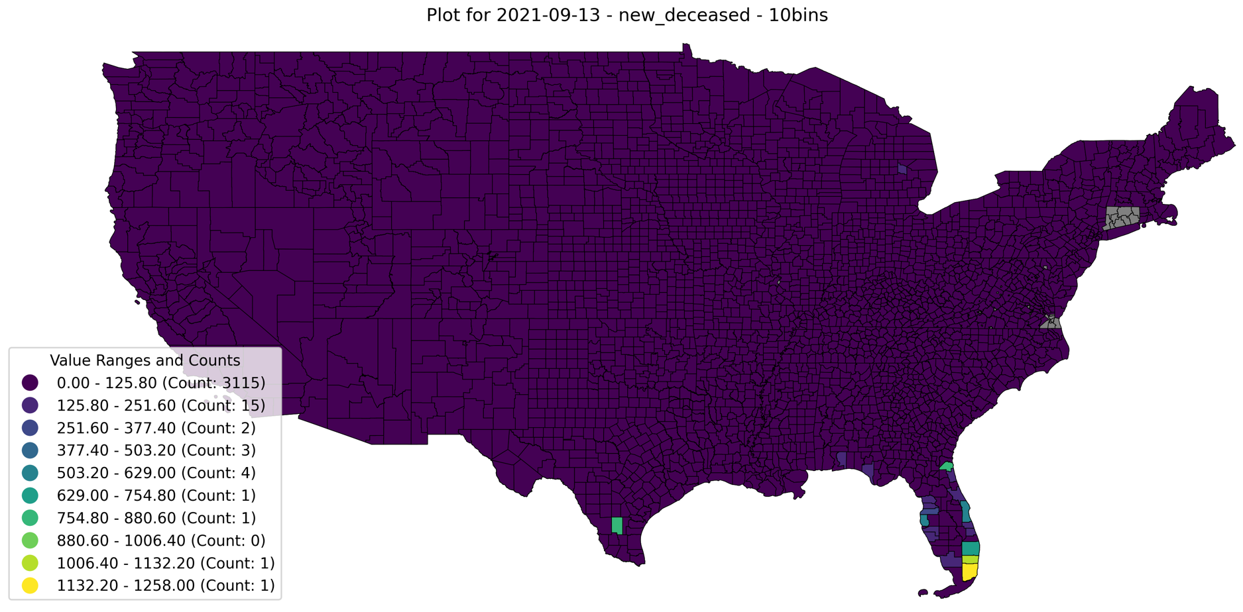
Geospatial on Worst County Outbreaks (Cont.)
Florida experienced a similar outbreak that was significantly more severe than other counties.
Different aggregation timeframes led to identifying different outbreaks.

Slide 10
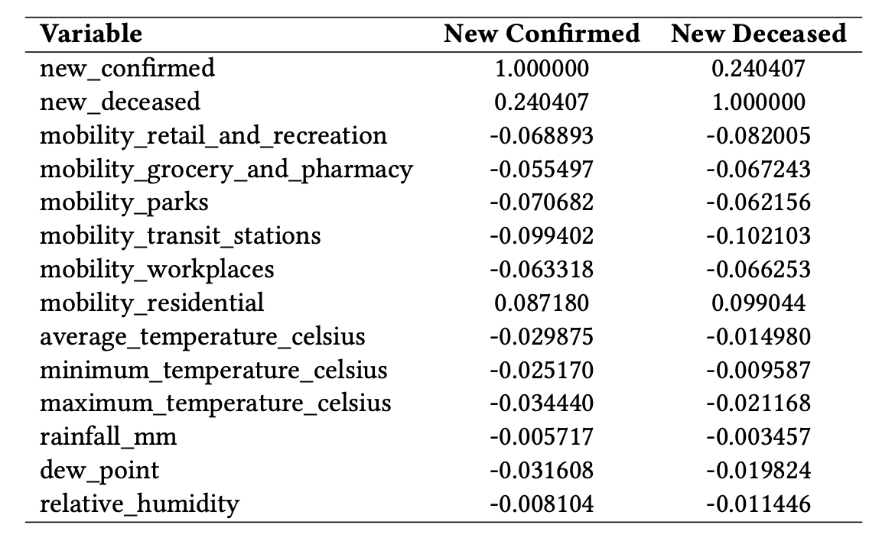

Correlation Analysis
Pearson Correlation Coefficients: Linear Relation.
Moderate positive correlation between the new confirmed cases and new deceased cases.
Mobility data show weak negative correlations with new confirmed cases
Residential mobility shows a weak positive correlation with new confirmed cases.
Temperature shows weak negative correlations with newly confirmed cases.
Notes:
Here I present for you the correlation Analysis results
We did calculate the Pearson Correlation Coefficients for the environmental and mobikity variables metrics shown in right table…
The coefficient quantifies the strength and direction of the linear relation between two variables.
Consistent with expected trends in infectious diseases

Slide 11
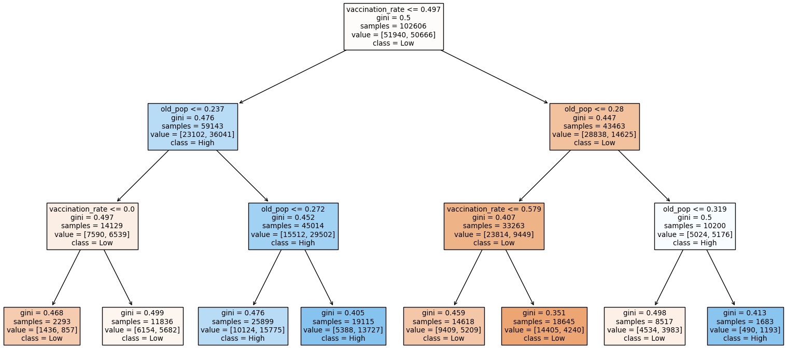
Impact of Vaccination on COVID-19 Death Rates
Decision Tree Classification
Feature variables: Vaccination Rate and Old Population Rate
Target variable: Death Rate
Increased vaccination rate in counties with higher older population rates decreases the mortality rate in the county.
This shows a correlation between vaccines and lower mortality rates for older populations.
Notes:
First, we observe the root node splits the dataset based on the vaccination rate. This suggests an initial significant relationship between the vaccination rate and death rates.
Other splits are using older population rate thresholds which show that higher vaccination rates generally correspond to lower death rates in regions with higher older population rate. In addition, in branches where the old population is high and vaccination rate is low, the classification shows a higher death rate.

Slide 12
Comparative Regression Analysis with and
without Lagged Variables - Ordinary Least Squares (OLS)
Objective: Examine the effectiveness of incorporating lagged variables into regression models for predicting COVID-19 cases.
Methodology: Two OLS regression models were developed; one with current environmental data and another enhanced with lagged environmental data from the previous week.
Rationale: To capture the delayed effects of environmental factors on COVID-19 transmission rates.

Slide 13
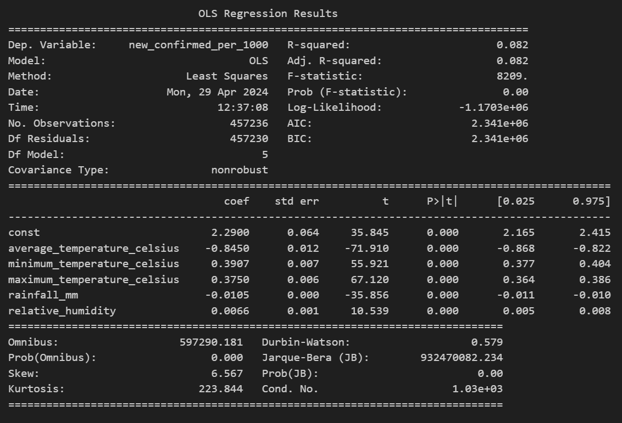
Initial Model without Lagged Variables
Variables Used: Average temperature, minimum temperature, maximum temperature, rainfall, and relative humidity.
Results Summary:
R-squared: 0.082, indicating that about 8.2% of the variability in new confirmed COVID-19 cases per 1000 people is explained by the model.
Significant predictors: All initial environmental factors had a noticeable impact on COVID-19 case predictions.

Slide 14
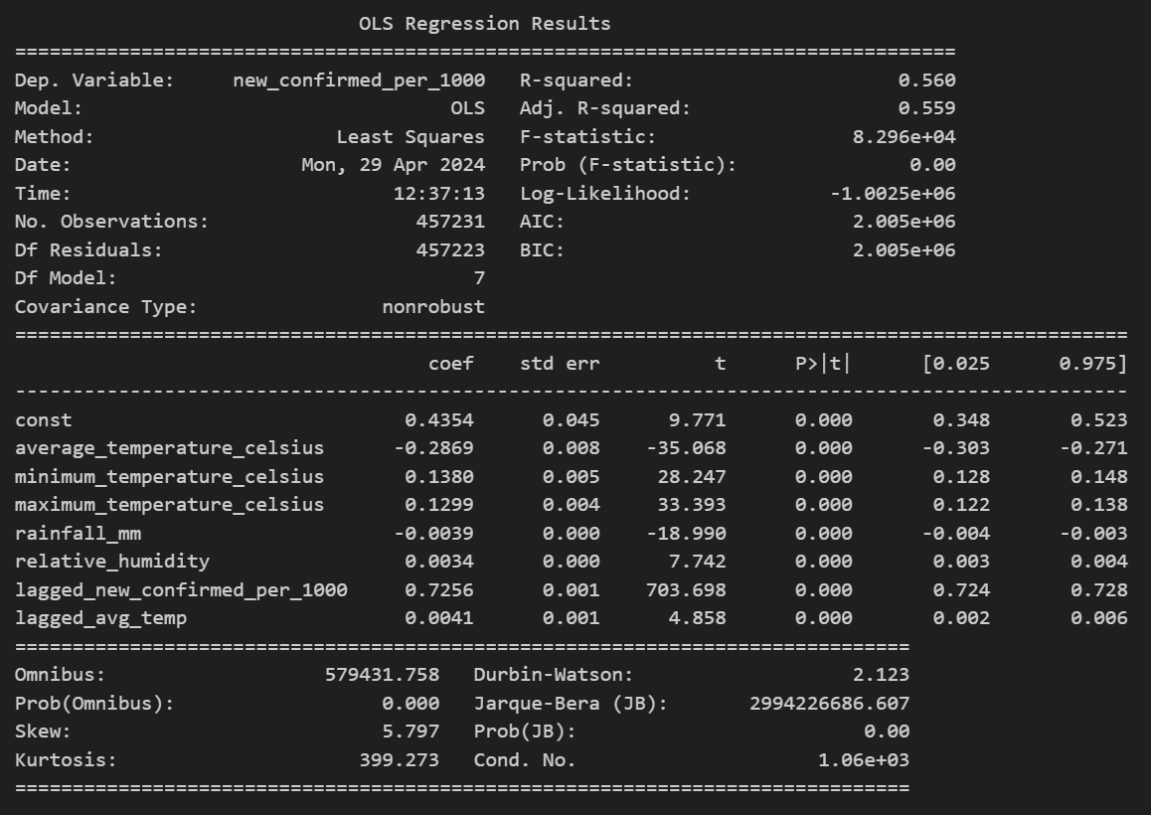
Enhanced Model with Lagged Variables
New Variables: Lagged confirmed cases and lagged average temperature were added.
Results Summary:
R-squared Improved to 0.560, showing that 56% of the variability is now explained by the model, significantly enhancing predictive accuracy.
F-statistic: Increased to approximately 82,960, underscoring the model’s robustness.

Slide 15
Comparative Analysis and Model Improvement
Improvements Noted:
Adjusted R-squared increased dramatically from 0.082 in the initial model to 0.560 in the enhanced model.
The Durbin-Watson statistic improved, indicating reduced autocorrelation among residuals.
Diagnostics Issues:
Omnibus and Jarque-Bera tests still indicate non-normal distribution of residuals, suggesting the presence of outliers or model misspecification.
Next Steps: Consideration of more sophisticated time-series models or transformations of the dependent variable to further refine model accuracy.

Slide 16
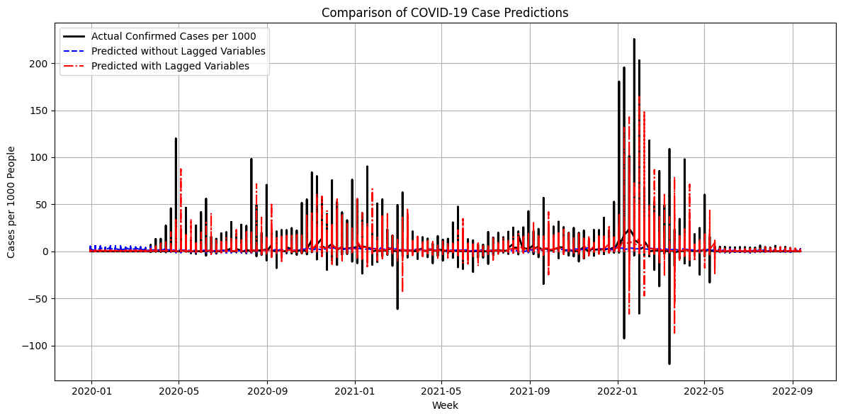
Visual Comparison and Conclusion
Conclusion: The inclusion of lagged variables significantly improves the model's ability to predict new COVID-19 cases, highlighting the importance of considering temporal dynamics in epidemiological modeling.

Slide 17
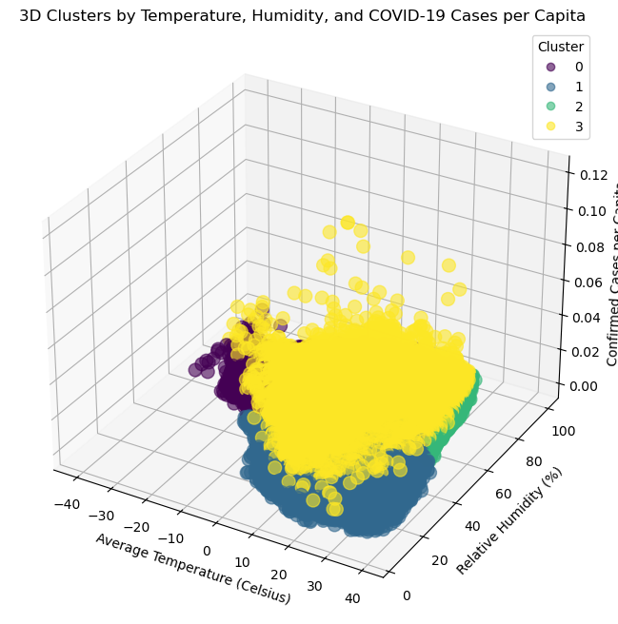
Impact of Weather on COVID-19 Rates
k-means clustering
4 clusters based in inertia
Decrease in the transmissibility of COVID-19 at temperatures exceeding 30°C, under 30°C, or under a 20% relative humidity.
Confirmed Cases Per Capita
Notes:
The resulting three-dimensional cluster visualization is displayed in Figure \ref{fig:3D-Cluster}. It is observable that cluster 3 is superimposed above clusters 0, 1 and 2, which indicates a higher incidence of confirmed cases within cluster 3. As shown in Figure \ref{fig:confirmedPerCluster}, cluster 3 confirmed cases rates are much higher than other clusters.
This analysis shows a decrease in the transmissibility of COVID-19 at temperatures exceeding 30\textdegree{}C, under 30\textdegree{}C, or under a 20\% relative humidity.
The reason for this decrease is not identified within the scope of this study. It could be due to reduced virus transmissibility in extreme weather conditions or decreased mobility in such conditions.

Slide 18
Knowledge Gained and Application
Infections seem to expand from one region to others.
There appeared to be at least two waves significant outbreaks.
Higher vaccination rates are related to lower COVID-19 death rates.
COVID-19 cases decrease in extreme climate.

